Slide 1
What Dermatologists & Surgeons Need To Know: Adjuvant Treatment for Resectable Stage II Melanoma
Jeffrey S. Weber, MD, PhD, FASCO, FAIO
Deputy Director and Head, Experimental Therapeutics
Co-Program Director, NYU SPORE in Melanoma
Laura and Isaac Perlmutter Comprehensive Cancer Center
Professor of Medicine and Perlmutter Professor of Oncology
NYU Grossman School of Medicine
New York, NY

Slide 2



Resource Information
About This Resource
These slides are one component of a continuing education program available online at MedEd On The Go titled Expanded Options in Adjuvant Immunotherapy for Resectable Melanoma: A Multidisciplinary Conversation
Program Learning Objectives:
Summarize the efficacy and safety data of clinical trials related to adjuvant treatment for resectable melanoma
Select individualized adjuvant immunotherapy regimens for patients with resectable melanoma, including risk/benefit analysis based on patient and disease characteristics
Identify and manage irAEs in the setting of adjuvant ICI therapy for resectable melanoma
Recognize the role of multidisciplinary, team-based care in clinical decision-making and implementation of multimodal treatment approaches for patients with resectable melanoma
MedEd On The Go®
www.mededonthego.com
This content or portions thereof may not be published, posted online or used in presentations without permission.
This content can be saved for personal use (non-commercial use only) with credit given to the resource authors.
To contact us regarding inaccuracies, omissions or permissions please email us at support@MedEdOTG.com

Slide 3
Disclaimer
The views and opinions expressed in this educational activity are those of the faculty and do not necessarily represent the views of Total CME, LLC, the CME providers, or the companies providing educational grants. This presentation is not intended to define an exclusive course of patient management; the participant should use their clinical judgment, knowledge, experience, and diagnostic skills in applying or adopting for professional use any of the information provided herein. Any procedures, medications, or other courses of diagnosis or treatment discussed or suggested in this activity should not be used by clinicians without evaluation of their patient's conditions and possible contraindications or dangers in use, review of any applicable manufacturer’s product information, and comparison with recommendations of other authorities. Links to other sites may be provided as additional sources of information.

Slide 4
KEYNOTE-716: Adjuvant Pembrolizumab Versus Placebo in Resected Stage IIB/IIC Melanoma
Adjuvant pembrolizumab significantly reduced the risk of recurrence, development of distant metastases, or death compared with placebo
RFSª
(primary endpoint)
DMFS^{b}
(secondary endpoint)

Slide 5
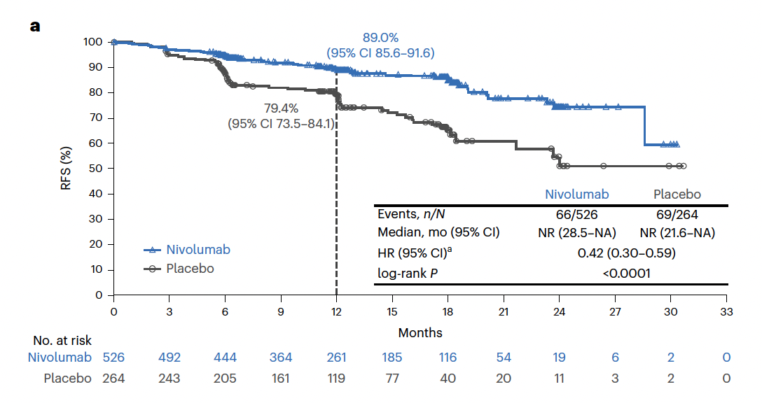
CheckMate 76K: Adjuvant Nivolumab Versus
Placebo in Resected Stage IIB/IIC Melanoma
Double-blind, randomized, placebo-controlled phase 3 study
Resected stage II B/C melanoma (N = 790)
Primary endpoint: recurrence-free survival
ITT population
Adjuvant nivolumab significantly reduced the risk of recurrence or death compared with placebo

Slide 6
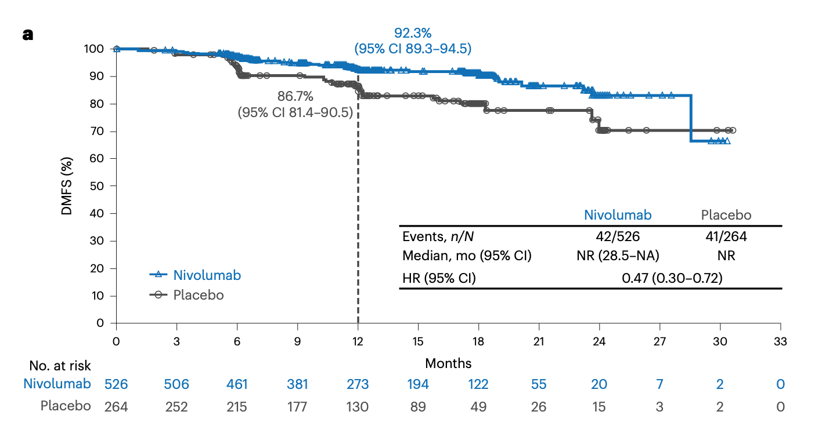
CheckMate 76K: Adjuvant Nivolumab Versus Placebo in Resected Stage IIB/IIC Melanoma
Adjuvant nivolumab significantly reduced the risk of distant metastasis-free recurrence or death compared with placebo

Slide 7
Conclusions: Adjuvant Therapy for High-Risk Stages IIB/IIC Resected Melanoma
Adjuvant single agent anti-PD-1 prolongs recurrence-free and distant metastasis-free survival in patients with stage IIB/C resected melanoma
Patients with resected stage IIB/IIC melanoma should be referred for consideration of adjuvant therapy
The greatest need in adjuvant therapy is biomarkers to select the highest-risk patients to avoid the toxicity of treatment in those who do not need treatment after surgery

Slide 8



Looking for more resources
on this topic?
CME/CE in minutes
Congress highlights
Late-breaking data
Quizzes
Webinars
In-person events
Slides & resources
www.MedEdOTG.com

