Slide 1
Case Consult: Adjuvant Therapy Following Localized Treatment for Stage III Melanoma
Sapna Patel, MD
Dr. William Robinson Endowed Chair in Cancer Research
The University of Colorado Cancer Center
Anschutz Medical Campus
Aurora, CO

Slide 2



Resource Information
About This Resource
These slides are one component of a continuing education program available online at MedEd On The Go titled Expanded Options in Adjuvant Immunotherapy for Resectable Melanoma: A Multidisciplinary Conversation
Program Learning Objectives:
Summarize the efficacy and safety data of clinical trials related to adjuvant treatment for resectable melanoma
Select individualized adjuvant immunotherapy regimens for patients with resectable melanoma, including risk/benefit analysis based on patient and disease characteristics
Identify and manage irAEs in the setting of adjuvant ICI therapy for resectable melanoma
Recognize the role of multidisciplinary, team-based care in clinical decision-making and implementation of multimodal treatment approaches for patients with resectable melanoma
MedEd On The Go®
www.mededonthego.com
This content or portions thereof may not be published, posted online or used in presentations without permission.
This content can be saved for personal use (non-commercial use only) with credit given to the resource authors.
To contact us regarding inaccuracies, omissions or permissions please email us at support@MedEdOTG.com

Slide 3
Disclaimer
The views and opinions expressed in this educational activity are those of the faculty and do not necessarily represent the views of Total CME, LLC, the CME providers, or the companies providing educational grants. This presentation is not intended to define an exclusive course of patient management; the participant should use their clinical judgment, knowledge, experience, and diagnostic skills in applying or adopting for professional use any of the information provided herein. Any procedures, medications, or other courses of diagnosis or treatment discussed or suggested in this activity should not be used by clinicians without evaluation of their patient's conditions and possible contraindications or dangers in use, review of any applicable manufacturer’s product information, and comparison with recommendations of other authorities. Links to other sites may be provided as additional sources of information.

Slide 4
Patient Case: Adjuvant Therapy Following Localized Treatment for Stage III Melanoma
A 68-year-old woman with a history of hypertension is diagnosed with a primary radial melanoma of the left leg measuring 2.0 mm without ulceration. WLE and SLN biopsy revealed 1 out of 2 positive lymph nodes in the ipsilateral groin (1/2). BRAF testing was negative for mutations and body and brain imaging revealed no evidence of distant disease.
She presents to the medical oncology office with her sister for a discussion of treatment options.

Slide 5
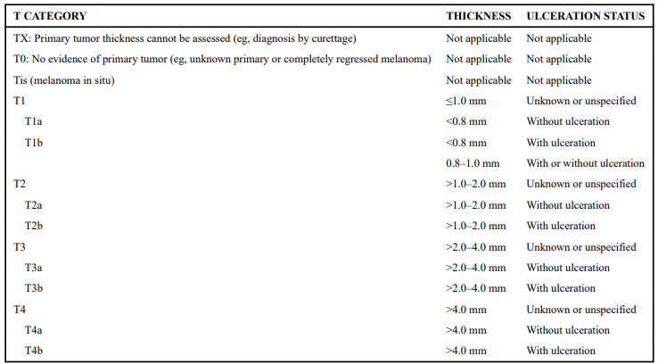
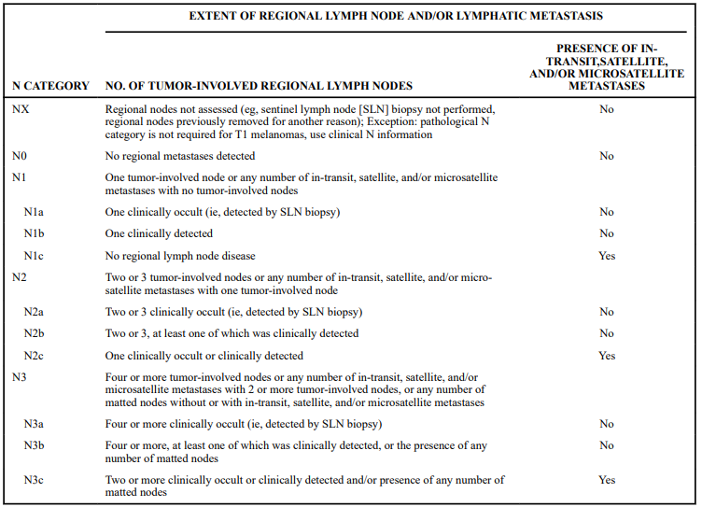
Patient Case: Adjuvant ICI Treatment for Stage II Melanoma
AJCC staging:

Slide 6
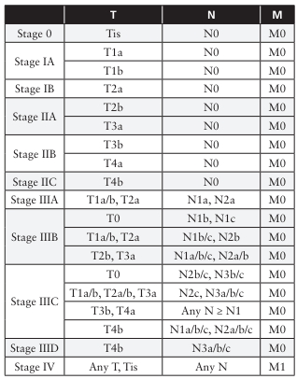
Patient Case: Adjuvant ICI Treatment for Stage II Melanoma
Pathological staging according to AJCC 8th edition:

Slide 7
Patient Case: Adjuvant Therapy Following Localized Treatment for Stage III Melanoma
Discussion points:
BRAF testing
Adjuvant treatment options:
  Pivotal trials: CheckMate-238, KEYNOTE-054, COMBI-AD
  Side effects
  Reduction in risk of recurrence or death
Number needed to treat/number needed to harm

Slide 8
Summary
Patients with fully resected stage III/IV melanoma have a risk of relapse with local therapy alone
Treatment with both anti-PD-1 inhibitors and BRAF-targeted agents improve recurrence-free survival when used as adjuvant treatment of resected stage III/IV melanoma
Treatment-related adverse effects:
  Risk should be communicated via shared decision-making conversations with patients
  Aggressive monitoring and management strategies positively impact patient quality of life and ultimately outcomes

Slide 9



Looking for more resources
on this topic?
CME/CE in minutes
Congress highlights
Late-breaking data
Quizzes
Webinars
In-person events
Slides & resources
www.MedEdOTG.com

