Slide 1

Choosing the Optimal Frontline Treatment Approach for Stage IV BRAF-Wild Type Melanoma

Slide 2



Resource Information
About This Resource
These slides are one component of a continuing education program available online at MedEd On The Go titled Holding Court in Melanoma: Choosing the Optimal Frontline Treatment Approach for Stage IV BRAF-Wild Type Melanoma
Program Learning Objective:
Understand the nuances of frontline regimens for stage IV melanoma which guide treatment choice
MedEd On The Go®
www.mededonthego.com
This content or portions thereof may not be published, posted online or used in presentations without permission.
This content can be saved for personal use (non-commercial use only) with credit given to the resource authors.
To contact us regarding inaccuracies, omissions or permissions please email us at support@MedEdOTG.com

Slide 3
Disclaimer
The views and opinions expressed in this educational activity are those of the faculty and do not necessarily represent the views of Total CME, LLC, the CME providers, or the companies providing educational grants. This presentation is not intended to define an exclusive course of patient management; the participant should use their clinical judgment, knowledge, experience, and diagnostic skills in applying or adopting for professional use any of the information provided herein. Any procedures, medications, or other courses of diagnosis or treatment discussed or suggested in this activity should not be used by clinicians without evaluation of their patient's conditions and possible contraindications or dangers in use, review of any applicable manufacturer’s product information, and comparison with recommendations of other authorities. Links to other sites may be provided as additional sources of information.

Slide 4
Frontline Treatment of Stage IV BRAF-Wild-Type Melanoma: What is the Optimal Combination ICI Regimen?
Ipilimumab + nivolumab
Nivolumab + relatlimab
  Long-term survival data
  Significant toxicity
  “Flipped-dose” regimen reduces toxicity and appears to maintain efficacy
  Shorter long-term survival data
  Reduced toxicity versus ipilimumab + nivolumab

Slide 5
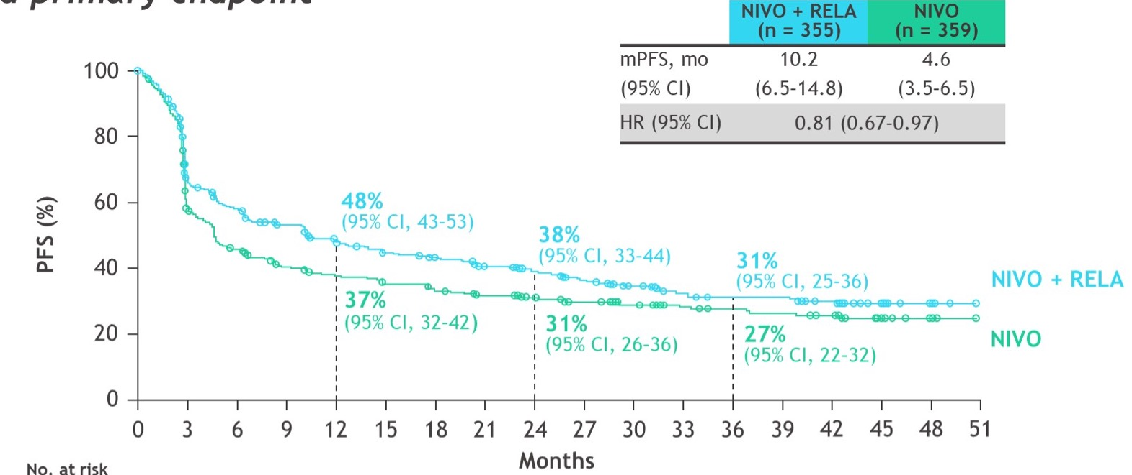
Nivolumab + Relatlimab Progression-Free Survival in RELATIVITY-047
Updated Primary Endpoint

Slide 6
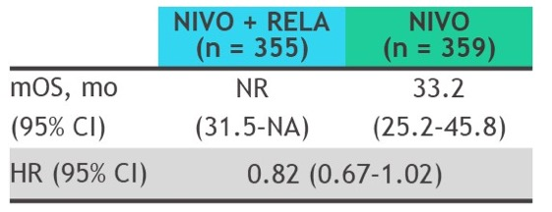
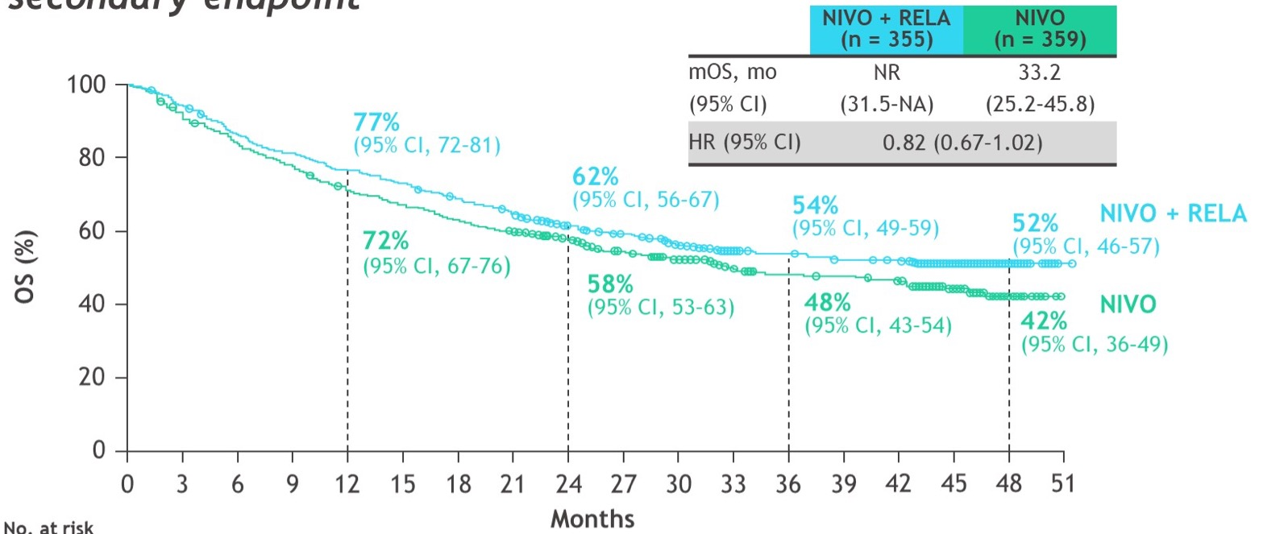
Nivolumab + Relatlimab Overall Survival in RELATIVITY-047
Updated Secondary Endpoint

Slide 7
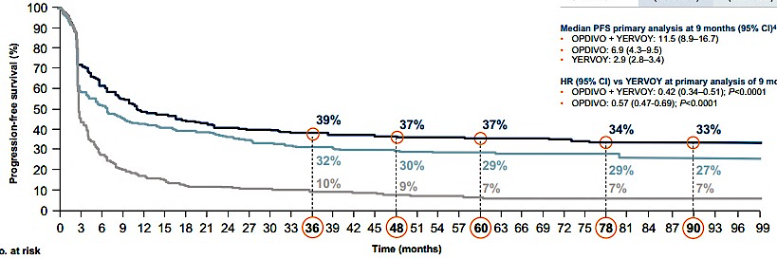
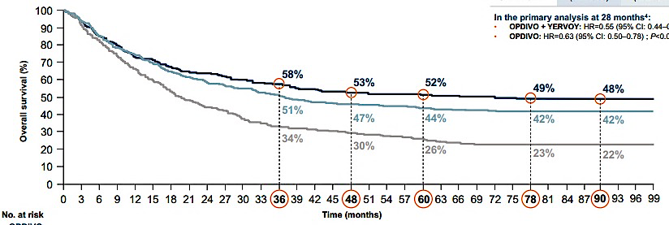
Ipilimumab + Nivolumab Survival Benefit in CheckMate 067
Progression-Free Survival
nivolumab + ipilimumab
nivolumab
ipilimumab
Overall Survival
nivolumab + ipilimumab
nivolumab
ipilimumab

Slide 8
CheckMate 067 Treatment-Free Interval Following Study Therapy Discontinuation
Patients analyzed were those who (1) were alive or (2) died following subsequent systemic therapy
Median duration of treatment was 3.6 mo (range, 0-80.1) with NIVO + IPI, 8.6 mo (0-79.8) with NIVO, and 3.7 mo (0-49.9) with IPI

Slide 9
Nivolumab + Relatlimab Progression-Free Survival in RELATIVITY-047
Updated Primary Endpoint

Slide 10
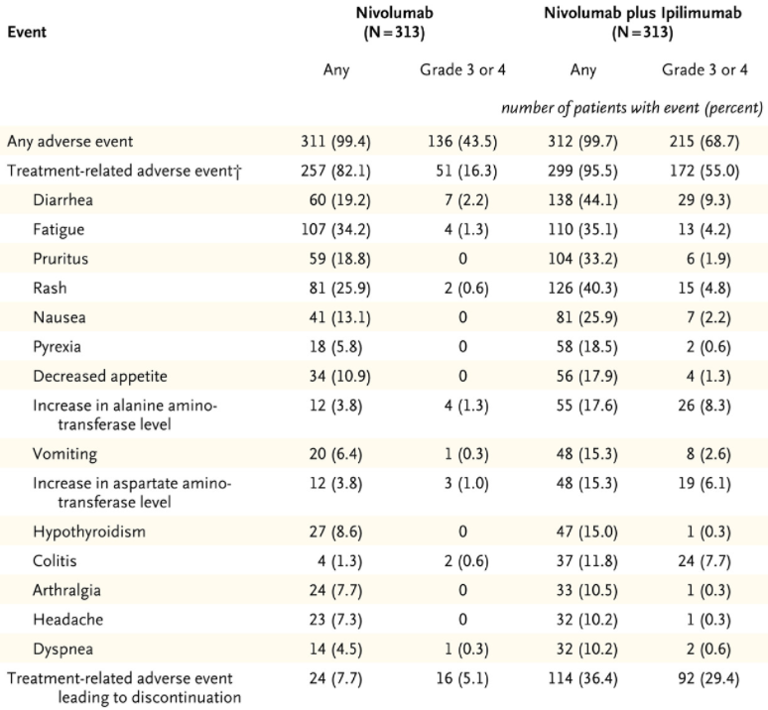
Toxicity of RELA + NIVO in
RELA-047 Versus with
IPI + NIVO in CM 067
AE, n (%) | NIVO + RELA (n = 355) | (n = 355) | NIVO (n = 359) | 359)
AE, n (%) | Any grade | Grade 3-4 | Any grade | Grade 3-4
Any AE | 352 (99) | 161 (45) | 344 (96) | 139 (39)
TRAE | 301 (85) | 78 (22) | 262 (73) | 43 (12)
Leading to discontinuation | 61 (17) | 34 (10) | 31 (9) | 14 (4)
Treatment-related deaths | 4 (1) | (1) | 2 (1) | (1)

Slide 11
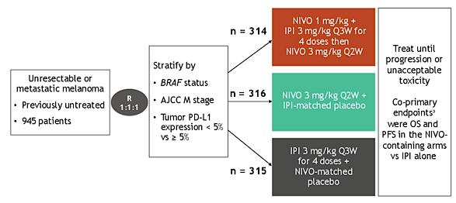
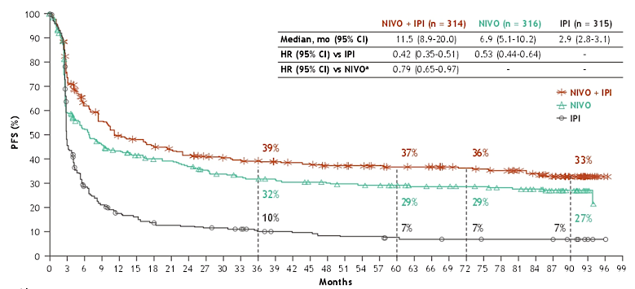
Patients with Advanced Melanoma Who Were Progression-Free at 3 Years on Immunotherapy in CheckMate 067

Slide 12
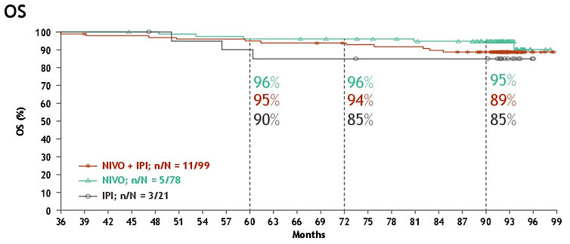
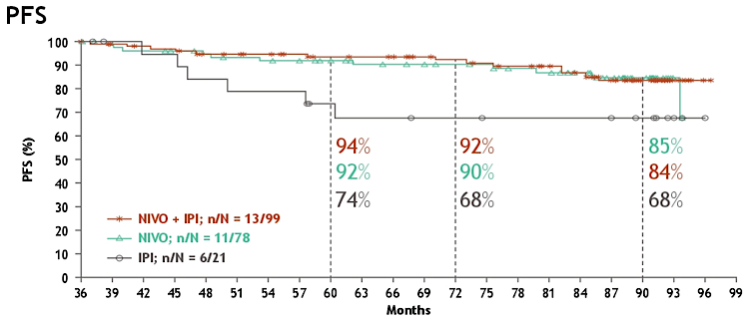
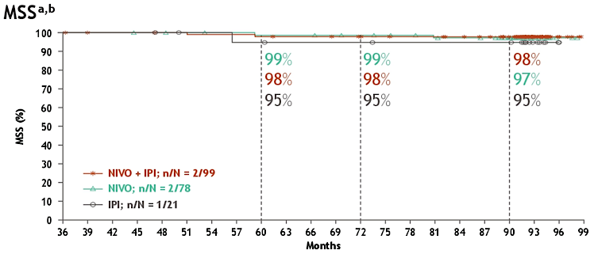
Survival Outcomes in Patients with Advanced Melanoma with PFS at 3 Years on Immunotherapy in CheckMate 067
OS
PFS
MSS^{a,b}
a. Descriptive analysis. b. An event was defined as death due to melanoma or euthanasia, and deaths for any other reason were censored.

Slide 13
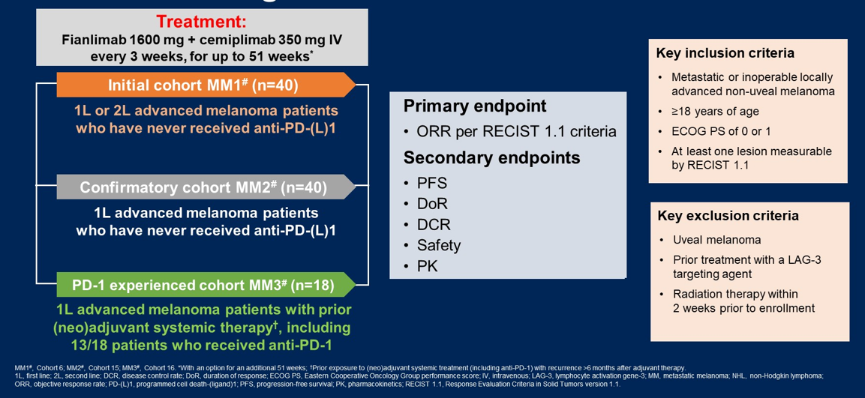
Fianlimab (Anti-LAG-3) + Cemiplimab (Anti-PD-1) Dosing Schema

Slide 14
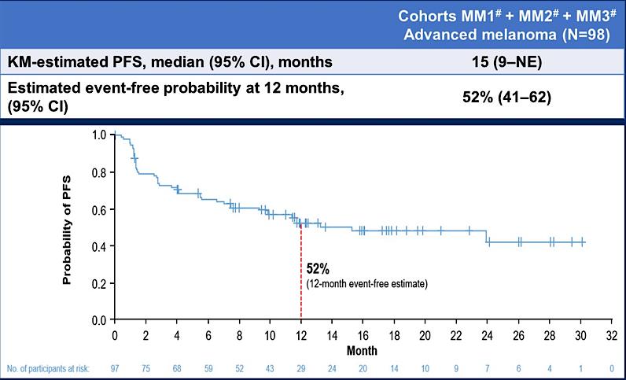
Fianlimab 1600 mg + Cemiplimab 350 mg IV Every 3 Weeks

Slide 15
Comparison of Tumor Response by ICI Regimen
 | Nivolumab 480 mg Q4W RELATIVITY-047¹ (N=359) | Nivolumab 480 mg + Relatlimab 160 mg Q4W RELATIVITY-047¹ (N=355) | Ipilimumab 3 mg/kg + Nivolumab 1 mg/kg Q3W x 4 doses CheckMate 067^{2,3} (N=314)
Median follow-up, months | 19.3 | 19.3 | 57.5
ORR, (95% CI) | 33% (28-38) | 43% (38-48) | 58% (53-64)
DCR | 51% | 63% | 71%
DoR, median (95% CI), months | NR (30-NE) | NR (30-NE) | NR (62-NE)
KM-estimated PFS, median (95% CI), months | 5 (3-6) | 10 (7-15) | 12 (9-19)

Slide 16
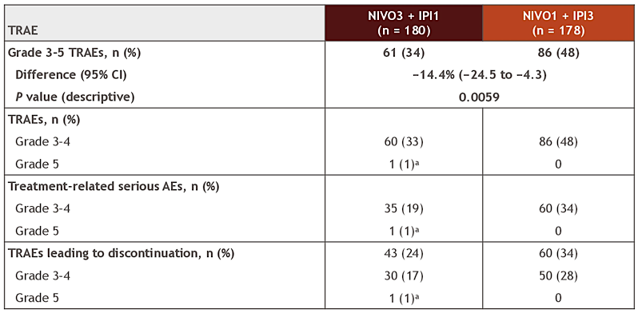
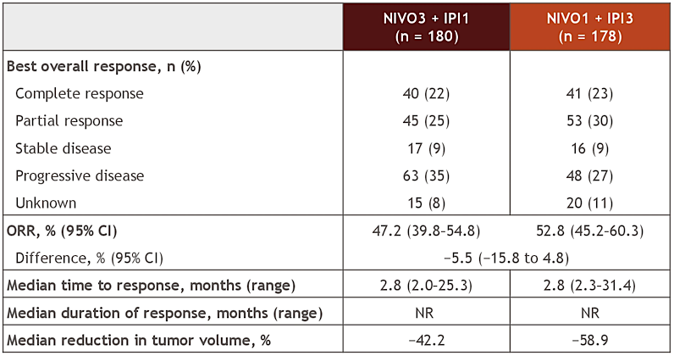
CheckMate 511: Two Dosing Regimens of IPI + NIVO
Safety Summary
Response per Investigator Assessment

Slide 17
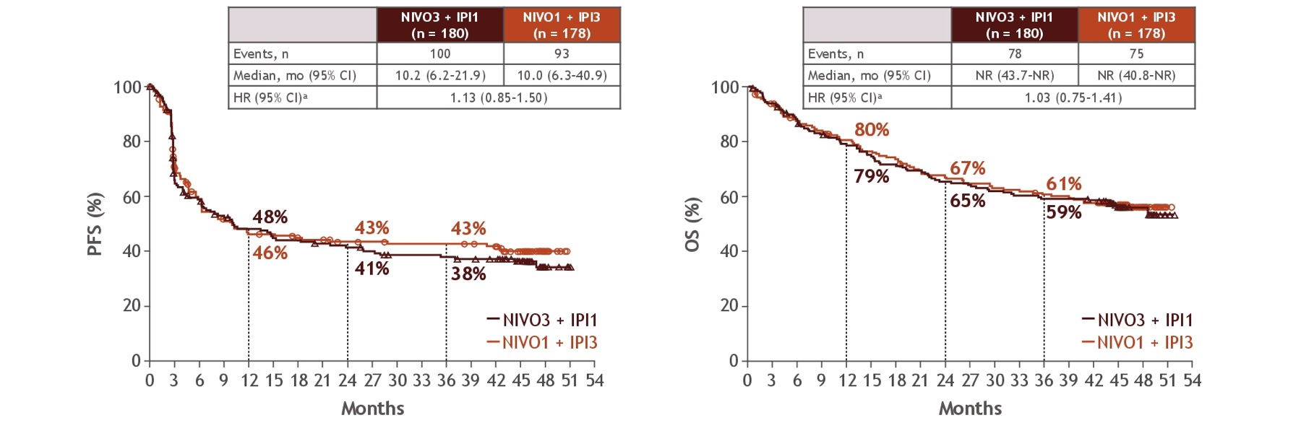
CheckMate 511: Two Dosing Regimens of IPI + NIVO
PFS
OS
Across patient subgroups, OS outcomes were generally similar with both regimens

Slide 18
Data Supporting Dual ICI Regimens in Metastatic Melanoma
Ipilimumab + nivolumab
Nivolumab + relatlimab
  Adjuvant stage IV: IMMUNED¹
  Brain metastases: CheckMate 204²
  Hepatic metastases³
  BRAF-mutant: CheckMate 067⁴
  7.5-year follow-up data: CheckMate 067⁴
  RELATIVITY-047⁵

Slide 19
Absolute Improvement in PFS and ORR of Anti-CTLA-4 and Anti-PD-1 Combination Regimens
CheckMate-067¹ | NIVO + IPI (n=314) | NIVO (n = 316) | Difference
Median progression-free survival, months (95% CI) | 11.5 (8.7-19.3) | 6.9 (5.1-10.2) | 4.6 months
Overall response rate | 58% | 45% | 13%
RELATIVITY-047² | NIVO + RELA (n=355) | NIVO (n=359) | Difference
Median progression-free survival, months (95% CI) | 10.2 (6.5-14.8) | 4.6 (3.5-6.5) | 5.6 months
Overall response rate | 44% | 34% | 10%

Slide 20
Efficacy of Anti-PD-1 + CTLA4 in CheckMate-067
 | IPI + NIVO (n=314) | NIVO (n=316) | IPI (n=315)
Overall response rate | 58% | 45% | 19%
Median progression-free survival, months (95% CI) | 11.5 (8.9-20.0) | 6.9 (5.1-10.2) | 2.9 (2.8-3.1)
Overall survival (95% CI) | 72.1 (38.2-NR) | 36.9 (28.2-58.7) | 19.9 (16.8-24.6)
Median Treatment-free interval (months) | 69.8 | 45.4 | 71.0

Slide 21
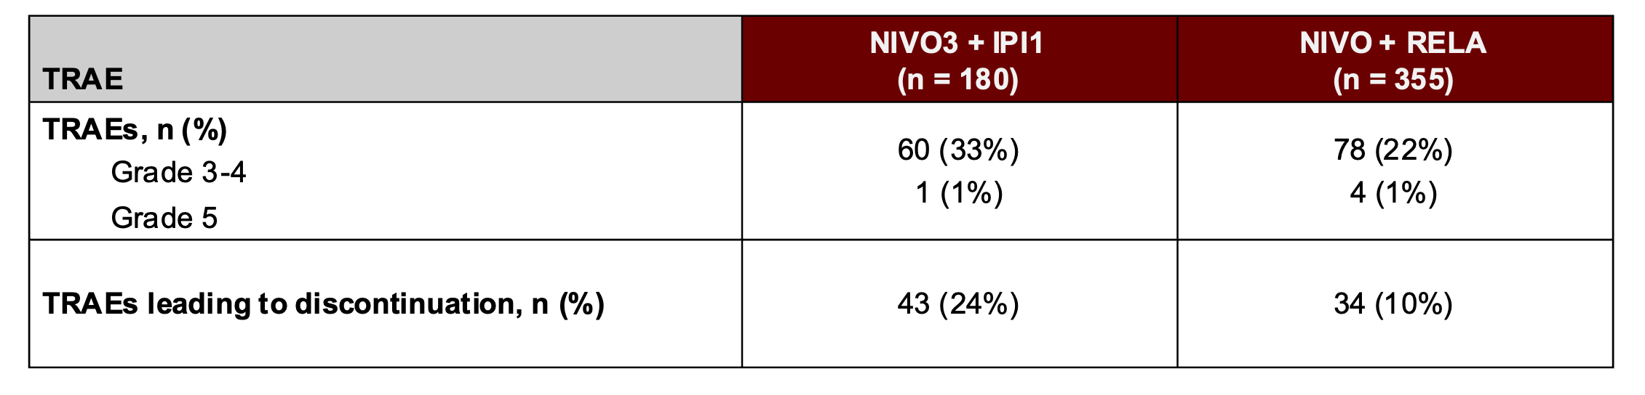
Safety Comparison
CheckMate 511: NIVO + IPI 1 mg/kg Versus RELATIVITY-047: NIVO + RELA

Slide 22
Toxicity of RELA + NIVO in
RELA-047 Versus with
IPI + NIVO in CM 067
AE, n (%) | NIVO + RELA (n = 355) | (n = 355) | NIVO (n = 359) | 359)
AE, n (%) | Any grade | Grade 3-4 | Any grade | Grade 3-4
Any AE | 352 (99) | 161 (45) | 344 (96) | 139 (39)
TRAE | 301 (85) | 78 (22) | 262 (73) | 43 (12)
Leading to discontinuation | 61 (17) | 34 (10) | 31 (9) | 14 (4)
Treatment-related deaths | 4 (1) | (1) | 2 (1) | (1)

Slide 23
Relative Benefit Versus Toxicity of Anti-PD-1 + Anti-LAG-3 Compared to Anti-CTLA-4 + Anti-PD-1
 | Nivolumab 480 mg Q4W RELATIVITY-047¹ (N=359) | Nivolumab 480 mg + Relatlimab 160 mg Q4W RELATIVITY-047¹ (N=355) | Ipilimumab 3 mg/kg + Nivolumab 1 mg/kg Q3W x 4 doses CheckMate 067^{2,3,4} (N=314)
Median follow-up, months | 19.3 | 19.3 | 57.5
ORR, (95% CI) | 33% (28-38) | 43% (38-48) | 58% (53-64)
KM-estimated PFS, median (95% CI), months | 5 (3-6) | 10 (7-15) | 12 (9-19)
Grade 3 or 4 TRAEs, No (%) | 43 (12%) | 78 (22%) | 189 (59%)

Slide 24
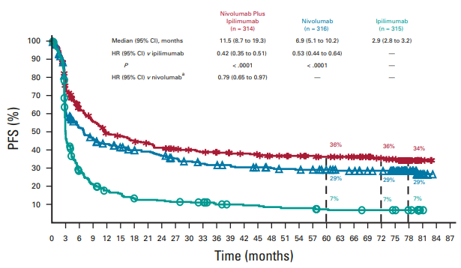
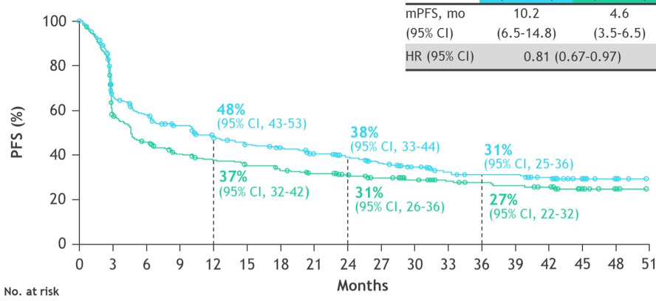
Progression-Free Survival: IPI + NIVO Versus NIVO + RELA
CheckMate 067¹
RELATIVITY-047²
HR versus NIVO=0.79
HR versus NIVO=0.81
NIVO + IPI
NIVO + RELA
NIVO
IPI
NIVO

Slide 25
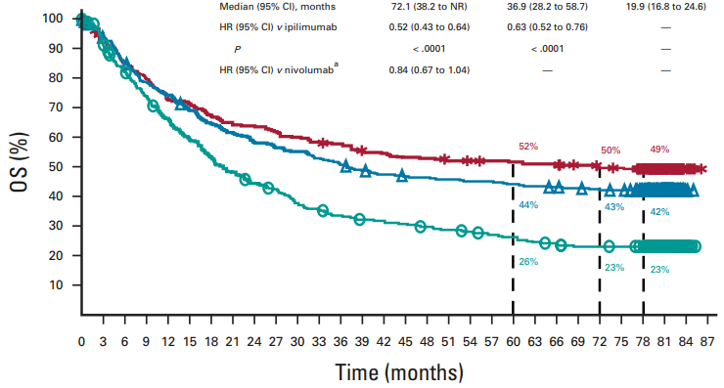
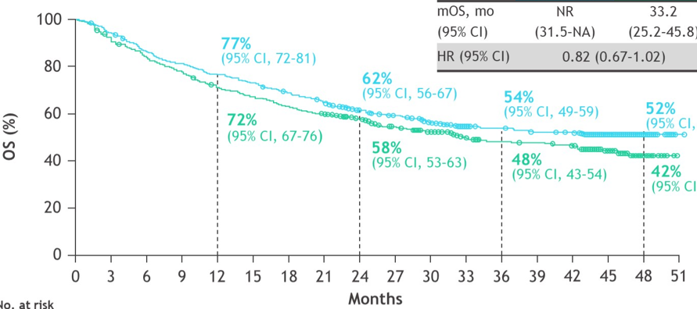
Overall Survival: IPI + NIVO Versus NIVO + RELA
CheckMate 067¹
RELATIVITY-047²
HR versus NIVO=0.84
HR versus NIVO=0.82
NIVO + IPI
NIVO + RELA
NIVO
IPI
NIVO

Slide 26
Anti-CTLA-4 + Anti-PD-1 Versus Anti-LAG-3 + Anti-PD-1 Therapy for Frontline Treatment of Stage IV Metastatic Melanoma
Anti-CTLA-4 + anti-PD-1
Anti-LAG-3 + anti-PD-1
  Long-term data exceeding 7.5 years
  OS, PFS, and ORR benefit over anti-PD-1 monotherapy
  Provides long treatment-free interval (18.1 months)
  Lacks OS benefit over anti-PD-1 monotherapy
  Lacks long-term data

Slide 27
Anti-CTLA-4 + Anti-PD-1 Versus Anti-LAG-3 + Anti-PD-1 Therapy for Frontline Treatment of Stage IV Metastatic Melanoma
Anti-LAG-3 + anti-PD-1
Anti-CTLA-4 + anti-PD-1
  Improved PFS and ORR over anti-PD-1 monotherapy
  Clinically meaningful OS benefit
  Significant rate of Grade 3/4 toxicity

Slide 28
Anti-CTLA-4 + Anti-PD-1 Versus Anti-LAG-3 + Anti-PD-1 Therapy for Frontline Treatment of Stage IV Metastatic Melanoma
Anti-LAG-3 + anti-PD-1
Anti-CTLA-4 + anti-PD-1
  Provides ORR and PFS benefit over anti-PD-1 monotherapy
  Median survival beyond 4 years
  Less than 20% rate of Grade 3/4 toxicity
  Median survival of 72 months
  Greater than 50% rate of Grade 3/4 toxicity
  Flipped dose (IPI1 + NIVO3) reduces toxicity rates

Slide 29



Looking for more resources
on this topic?
CME/CE in minutes
Congress highlights
Late-breaking data
Quizzes
Webinars
In-person events
Slides & resources
www.MedEdOTG.com

